Slide 1
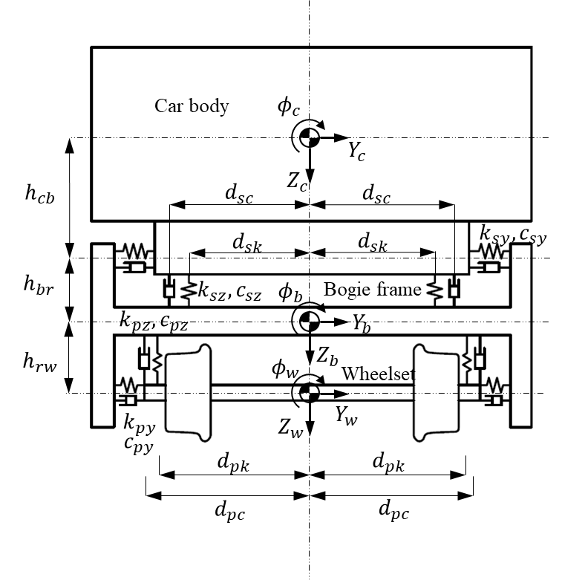

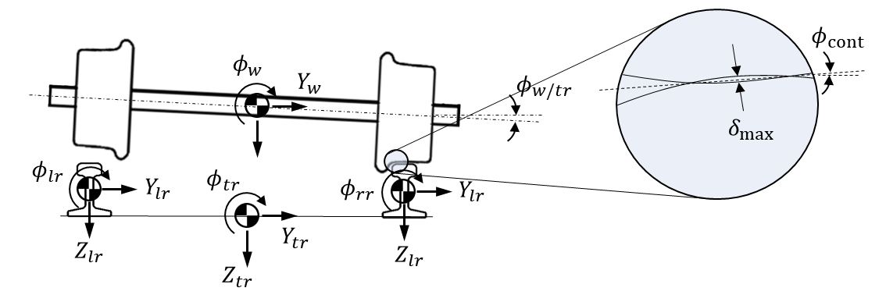

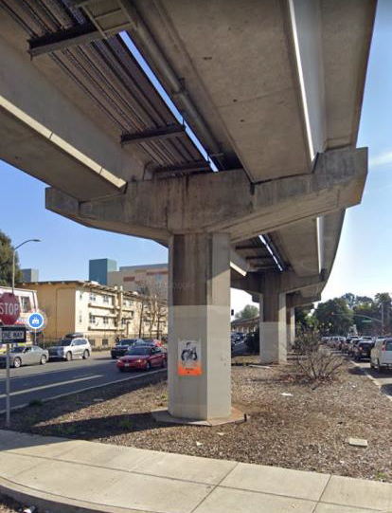
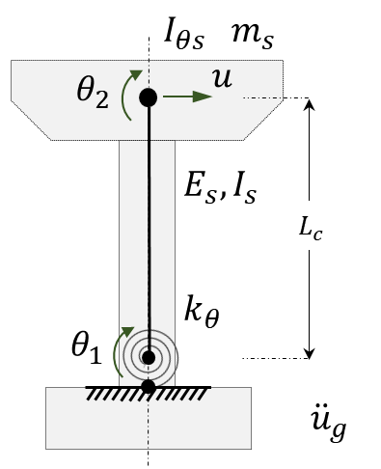

Train-Structure Interaction and Regional Simulation of BART Railway Network
Miguel Gomez (miguel.gomez.f@berkeley.edu)
Advisor: Matthew DeJong
Started in 2021 (MS)

Slide 2
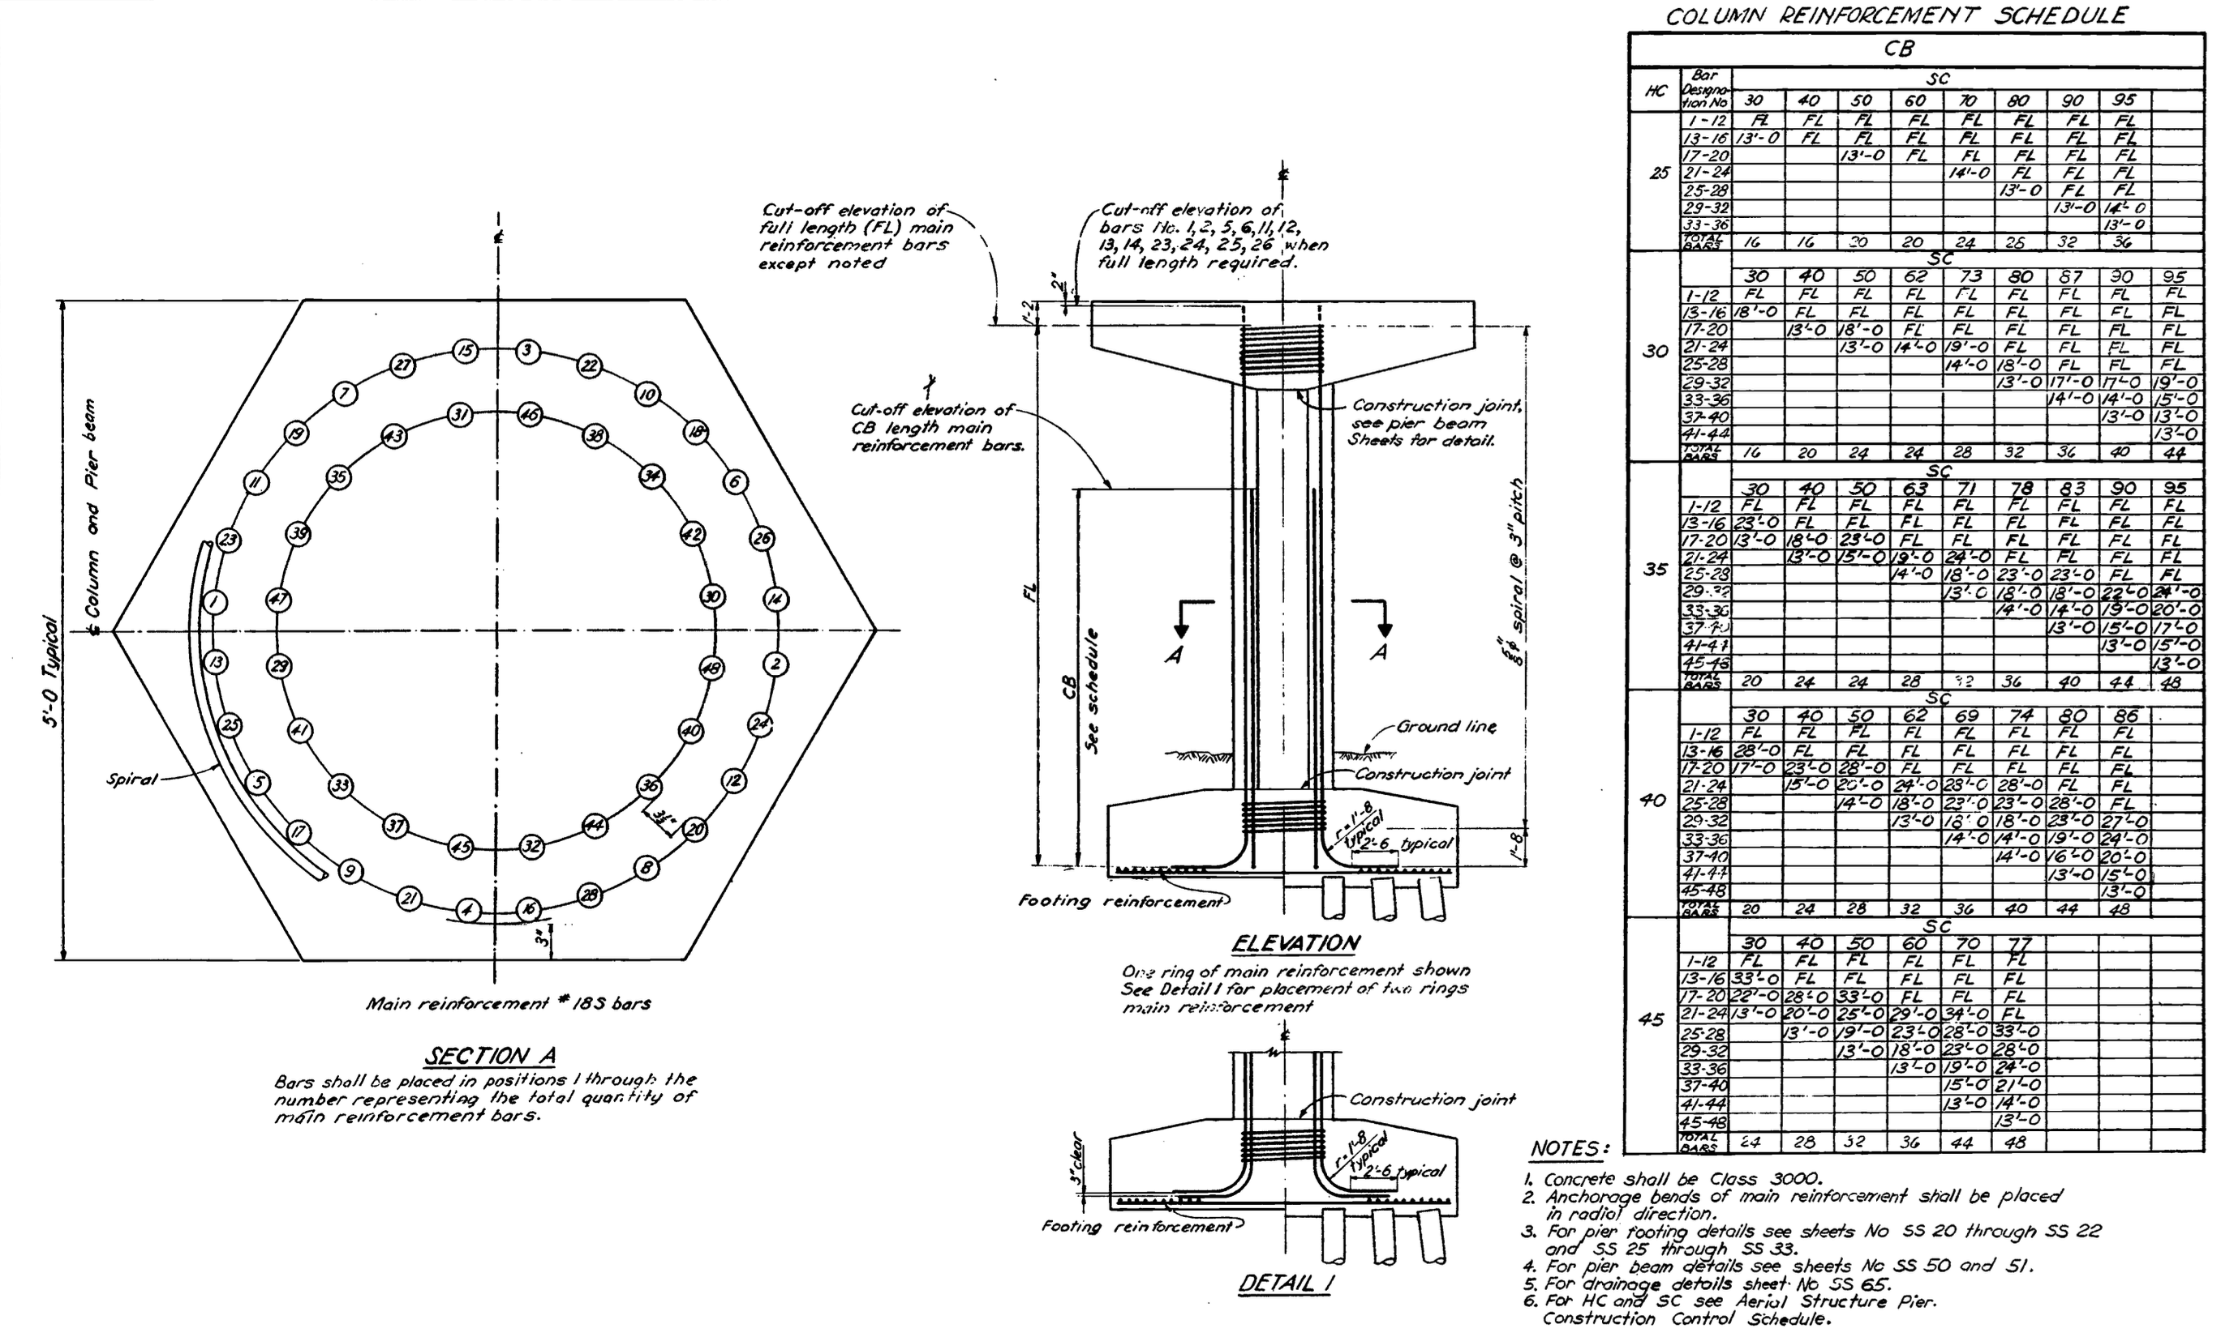
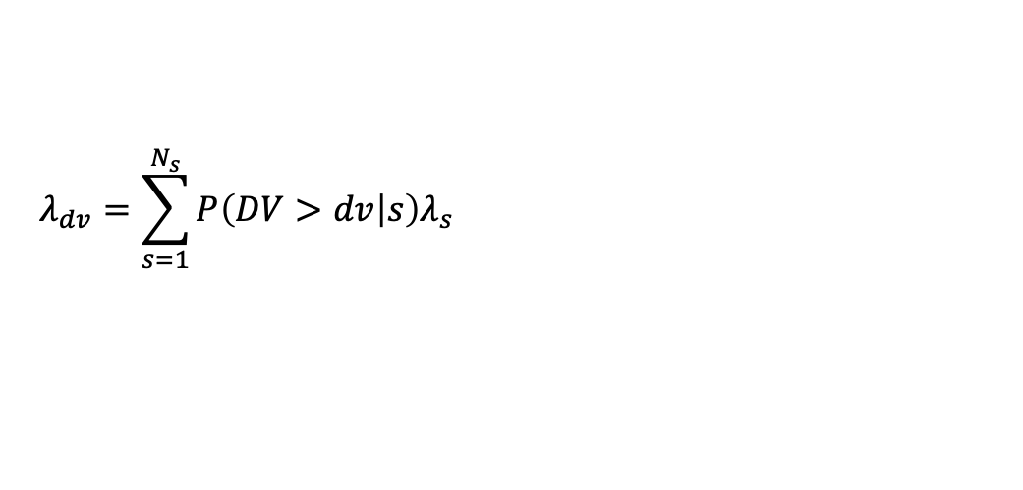
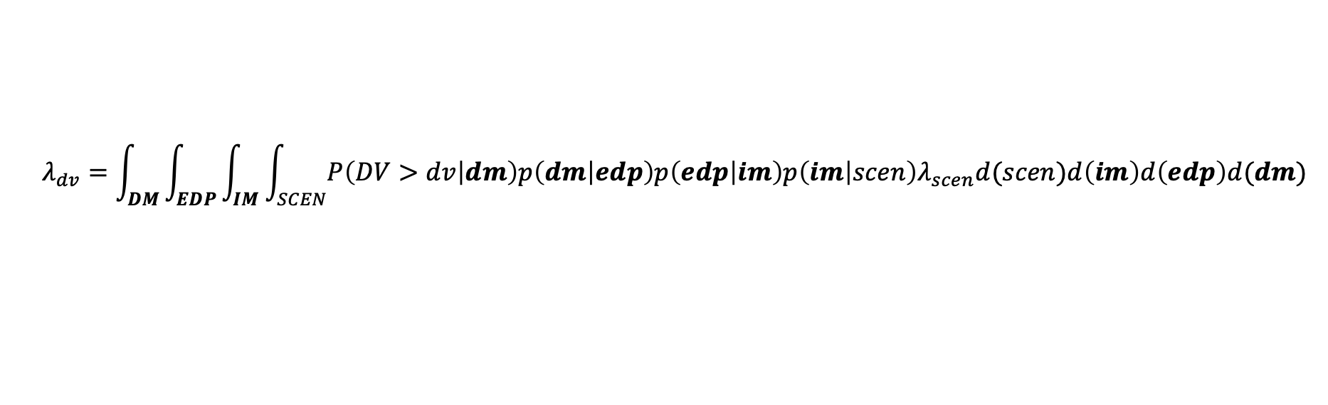
From as-built drawings get the hysteresis behavior.
Evaluate risk (of derailment, for instance)
$$λ_{dv}=\int_{DM}{\int_{EDP}{\int_{IM}{\int_{SCEN}{P\left(DV>dv | dm\right)p\left(dm | edp\right)p\left(edp | im\right)p\left(im | scen\right)λ_{scen}d(scen)d\left(im\right)d\left(edp\right)d(dm)}}}}$$
$$λ_{dv}=\sum_{s=1}^{N_{s}}{P\left(DV>dv | s\right)λ_{s}}$$

